Slide 1

Regional Sales Summary
R. Buntrock
23.09.2025

Slide 2
Regional Sales Summary
Problem Statement
analyse and visualize regional sales data to understand inconsistent revenue and profit performance across U.S. regions
evaluate profitability for top SKUs, and channel profitability
support strategic decision-making.
Goal
Leverage 5 years of historical data to pinpoint growth levers and optimize strategy

Slide 3
Project Workflow
Understand business problem and objective
Gather relevant data
Understand data
Merge and clean data
Exploratory Data Analysis
Extract key insights and trends
Present findings

Slide 4
Approach
The provided dataset was loaded analyzed using Python‘s pandas library. Matplotlib and Seaborn were used for visualisations
The data was loaded, merge and checked for duplicates, outlier or missing data
Time-series plots and bar charts were used for visualizations
The findings and recommendations are presented in this presentation

Slide 5
Data Overview
State Regions
State Code
State
Region
Sales data for US sales were provided in a spreadsheet, containing separate tabs including sales orders, regional information, customer information, product IDs and budget data.
The dataset includes 64104 sales records from 2014-2018.
Regions
id
name
county
state_code
state
type
latitude
longitude
area_code
population
households
median_income
land_area
water_area
time_zone
Sales Orders
OrderNumber
OrderDate
Customer Name Index
Channel
Currency Code
Warehouse Code
Delivery Region Index
Product Description Index
Order Quantity
Unit Price
Line Total
Total Unit Cost
Customers
Customer Index
Customer Names
Products
Index
Product Name
2017 Budgets
Product Name
2017 Budgets

Slide 6
Exploratory Data Analysis

Slide 7
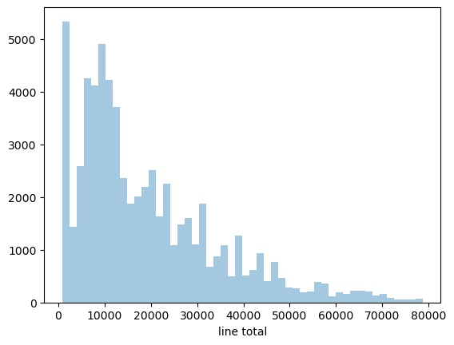
Overall Sales Statistics
Distribution of sales order volume
Total Revenue: $1,235,968,899
Total Profit: $461,772,556
Average Order Value: $19,280.68
Largest Order Value: $78,711.60
Total Orders: 10684
Total Unique Customers: 175
Total Unique Products: 30

Slide 8
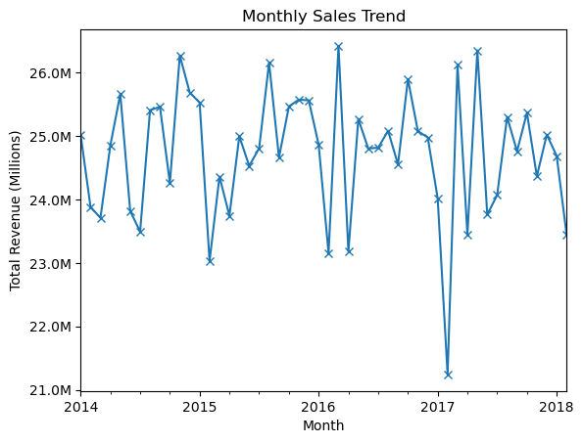
Historical sales volumes (total)
The overall trajectory does not show a consistent upward or downward movement over the 4 years.Sales fluctuate significantly month-to-month, indicating a volatile market or seasonal influences.
The is a major dip in early 2017
The business may be influenced by seasonal cycles, market conditions, or product launches.

Slide 9
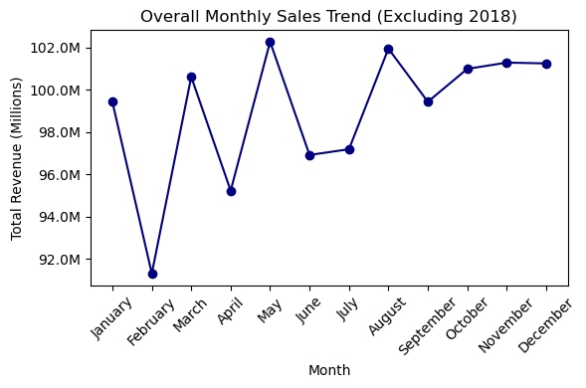
Monthly Revenue (Seasonality)
February shows the lowest revenue, around 92.0M, suggesting a post-holiday slowdown
May marks the highest peak, reaching approximately 102.0M
August also shows a strong performance, just below May’s peak.
June and July experience a slight decline, with revenues around 96.0M, possibly due to summer holidays or reduced business activity.
From September to December, sales remain relatively stable, fluctuating around 100.0M, indicating consistent performance during the final quarter.

Slide 10
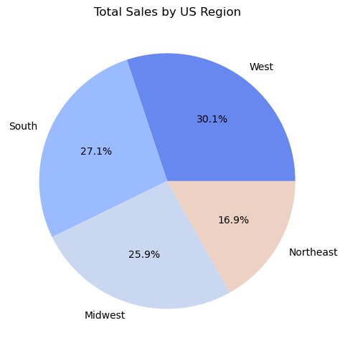
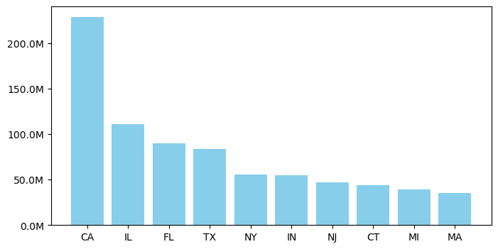
Sales by US Region
The West region is the strongest region, while the Northeast is trailing at around 17% in total sales
California leads by a wide margin, generating about $230 M in revenue more than twice the next-highest state.
Illinois, Florida, and Texas form a second group, each generating around $85–110 M in revenue

Slide 11
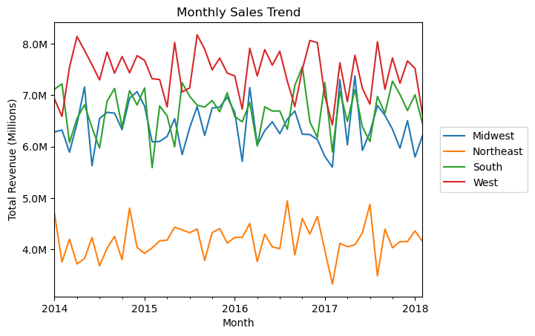
Historical Sales by US Region
West region showing the highest revenue for almost all months, while the Northeast is consistently the lowest
No region shows a particular upward or downward trend over the analyzed period

Slide 12
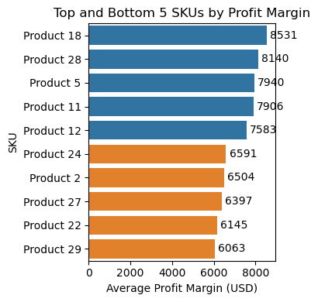
Top and Bottom performing SKUs
The top performing SKUs generate about 8k USD, while Product 18 is leading with 8531 USD.
The lowest grossing products are generating below 6600 USD on average, as low as 6063 for product 29.
Understanding the cost and pricing structure between these products good positively impact the bottom line.

Slide 13
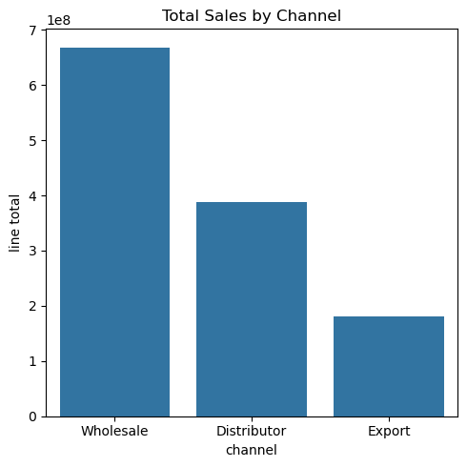
Sales by Channel
Wholesale channels contribute 54% of total sales, followed by distributors at approximately 31% and exports at 15%, highlighting a strong dependence on domestic bulk sales.
To reduce revenue concentration and enhance resilience, focus on expanding export operations through targeted international marketing and cultivating strategic partnerships abroad.

Slide 14
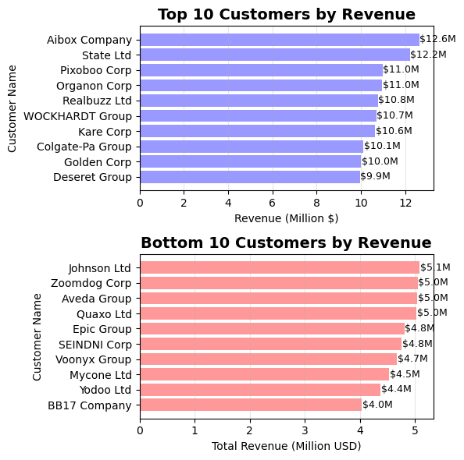
Customer Ranking
Aibox Company and State Ltd are the two customers with the highest revenue by a wide margin. Closely followed by a group with around $10-11M.
The bottom 10 customers generate around $5M in revenue, while the smallest customer is BB17 Company with $4M.

Slide 15
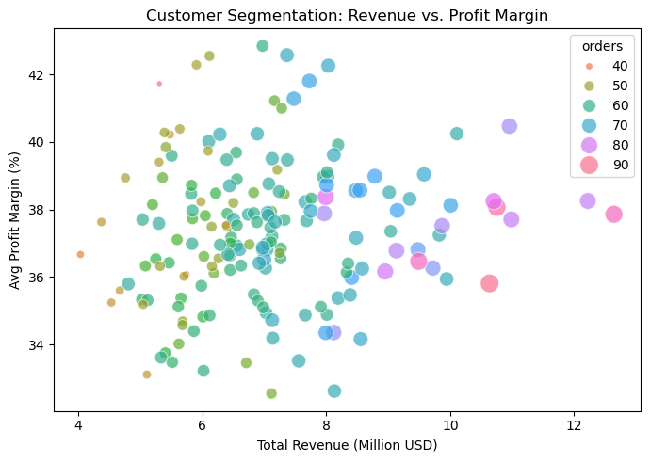
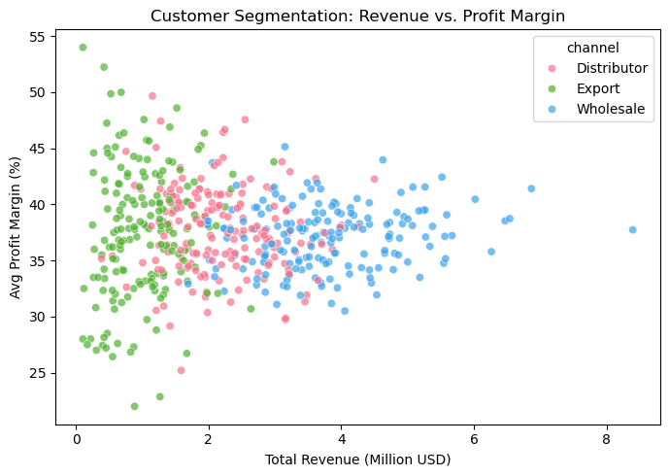
Customer Segmentation
All customers purchase through all 3 sales channels with varying degree
Customers ordering via Export tend to order smaller volumes <$2 M at highly variable profit margins (%)
Customers purchasing over $3 M tend to buy through Wholesale channels at stable margins (~34–40%), suggesting consistent pricing in this tier.

Slide 16
Key insights
Average revenue is consistent over the years among regions and different sales channels
End of the year shows consistently high revenue while the remaining months fluctuate
West region generates the highest revenue with California being the strongest state.
Northeast Region is lowest performer
Largest sales channel is Wholesale, exports is the lowest

Slide 17
Recommendations
Boost sales in Northeast through marketing.
Anticipate the fluctuations and decrease inventory or increase sales activities.
improve cost structure for low performing SKUs
Grow export channel to rely less on Wholesale
Maintain relationships with TOP 10 customers

